Slide 1

NephroTrack
Client Pitch Presentation
Team 33 – SDP Plc
25th March 2025

Slide 2
Team Members
Joe Coffee – Project Leader
Ben Hunter – Security Analyst
Lynk Kunieda-Frater – Analyst Designer
Daniel Olufowora – Analyst Designer
Brian Castro Nunez – Developer
Aleks Mihaylov – Developer
Anwar Noh – Software Tester

Slide 3
Project Overview
Team 33 NephroTrack operates within SDP Plc, a solutions-based software company specialising in healthcare.
We were tasked with creating a CKD risk calculator for use by NHS clinicians and long-term patients.
The tool supports clinicians during consultations, allowing fast, clear eGFR calculations.
It also empowers “expert patients” to monitor their own CKD status outside of clinical settings.
Our agile-based approach promotes collaboration, security-first thinking, and user-focused design.
We prioritised usability, accessibility, and data safety in response to the client’s emphasis on simplicity and confidentiality.
Due to the 2021 NICE (National Institute for Health and Care Excellence) guideline, the recommendation to adjust for ethnicity, which was present in the 2014 version of the calculations, has been removed.
Note: CKD refers to Chronic Kidney Disease, CKD-EPI is the CKD Epidemiology Collaboration, and eGFR stands for Estimated Glomerular Filtration Rate, a key metric used to assess kidney function, and Nephro refers to the study of Kidneys within medicine. MDRD stands for Modification of Diet in Renal Disease, is still utilised in calculation as it is more accurate for late stage patients suffering with kidney disease, while the CKD-EPI is still more widely used for early and normal kidney function tests.

Slide 4
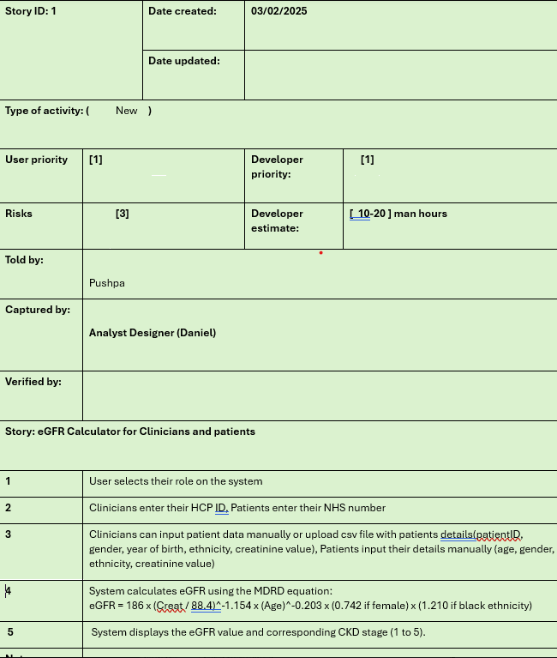
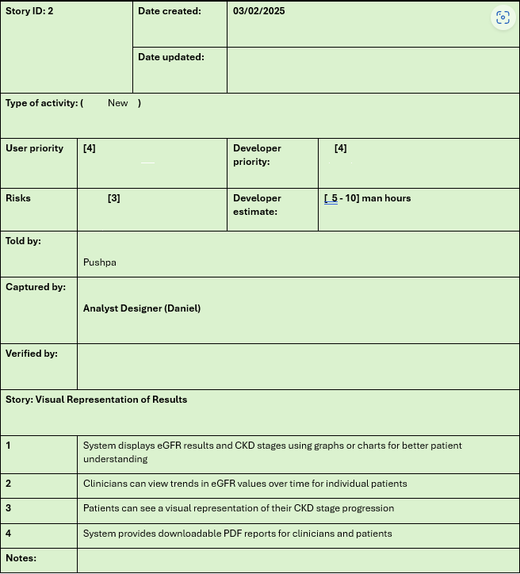
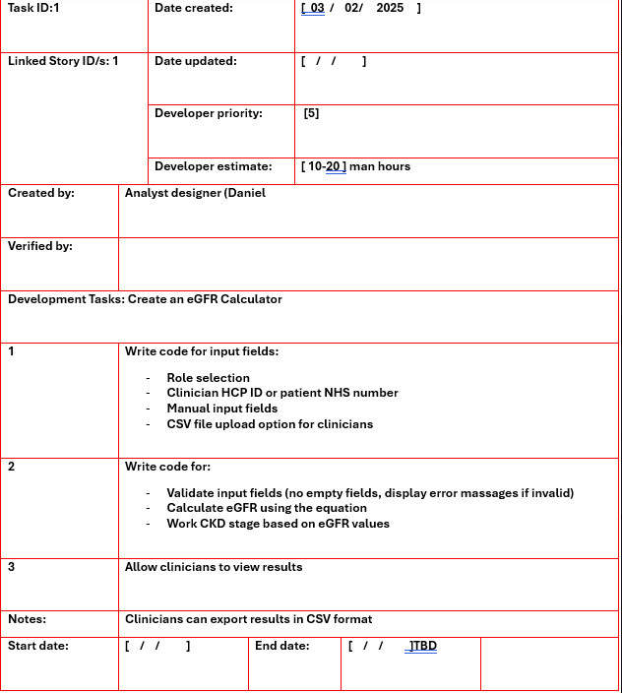
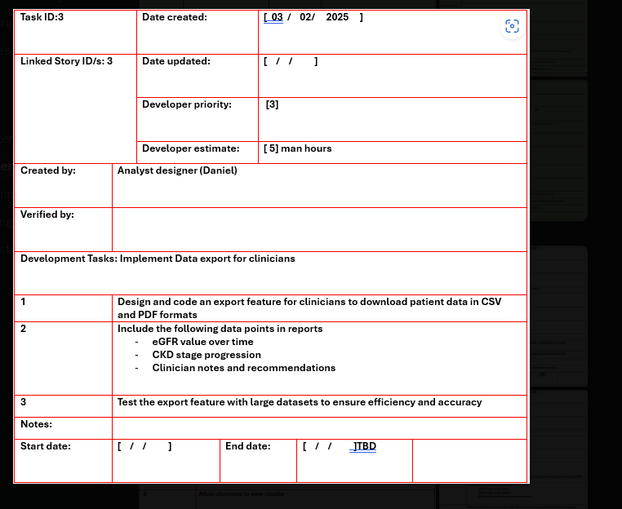
Initial Planning & Requirements
Our first step was to outline a user journey and understand key expectations from both clinicians and patients.
We achieved this by creating a structured set of story cards and task cards to define features and prioritise them.
These artefacts helped us map out user needs, technical requirements and the development roadmap for NephroTrack.
Story Cards
Task Cards

Slide 5
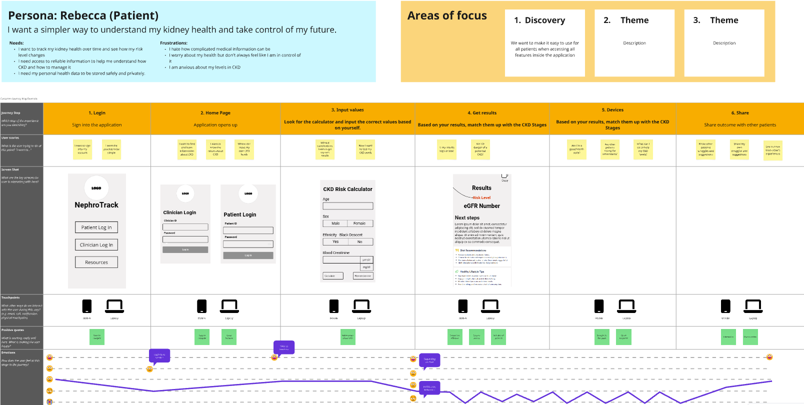
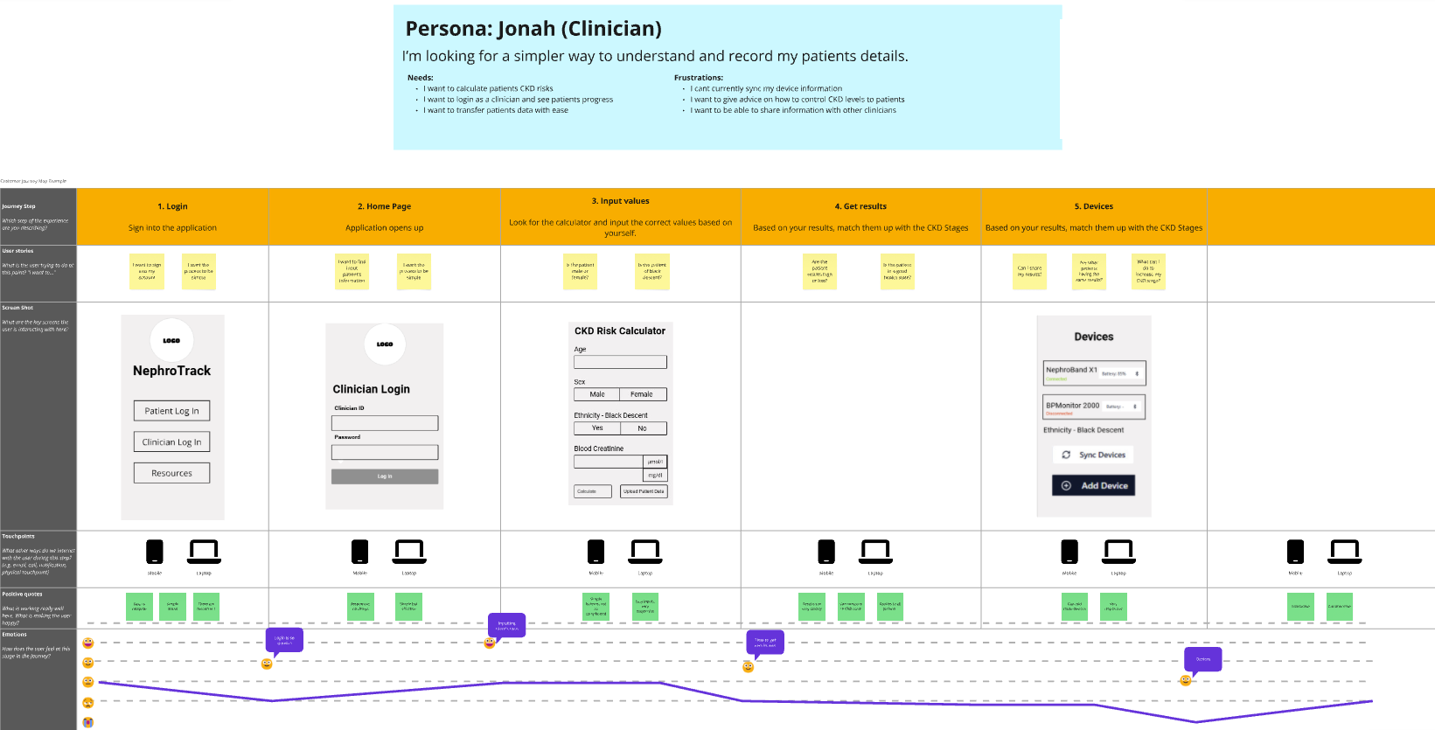
User Journeys

Slide 6
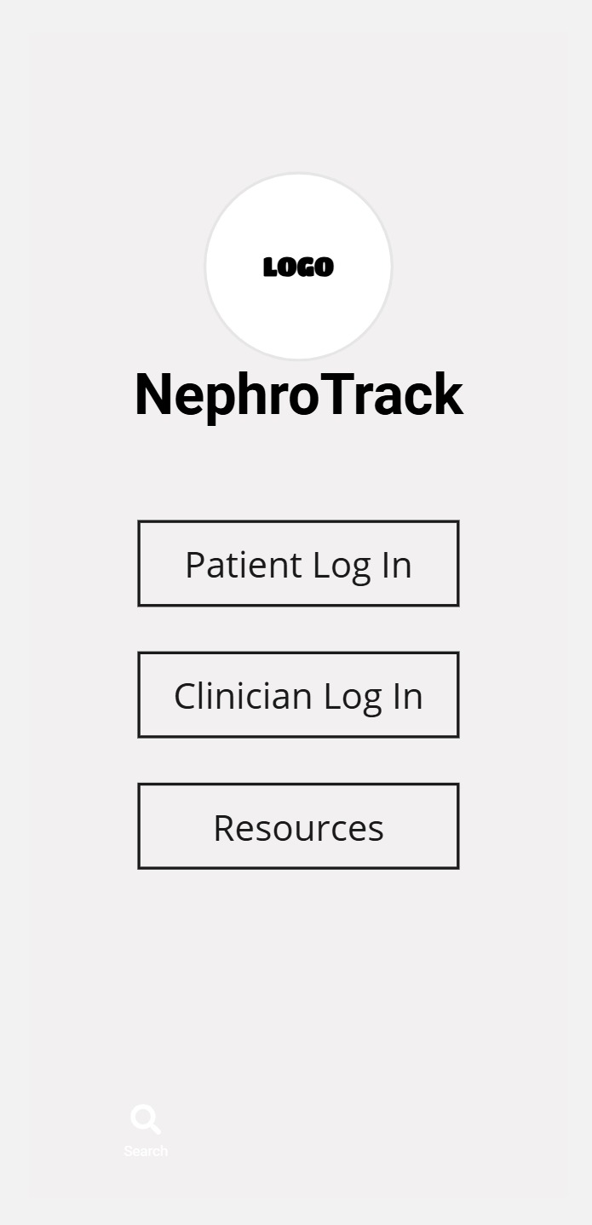
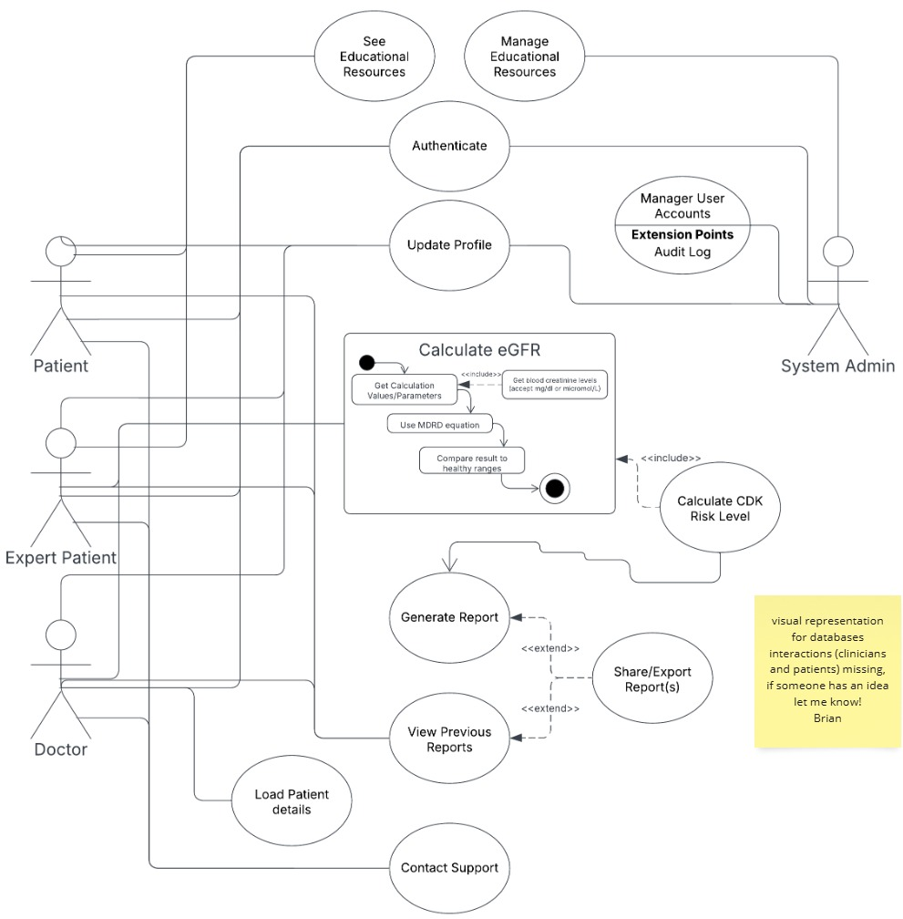

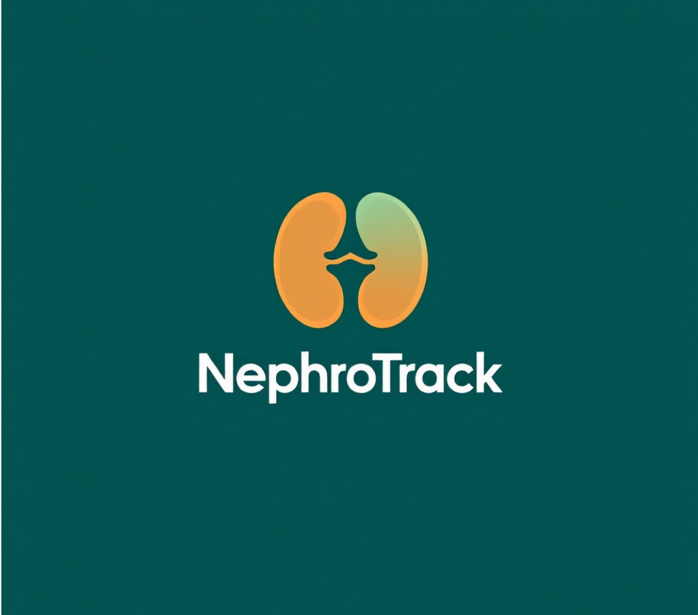
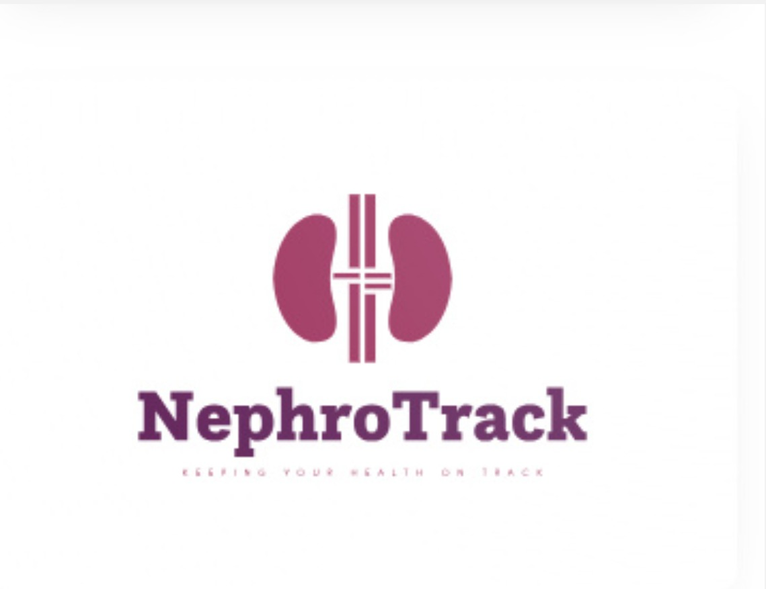
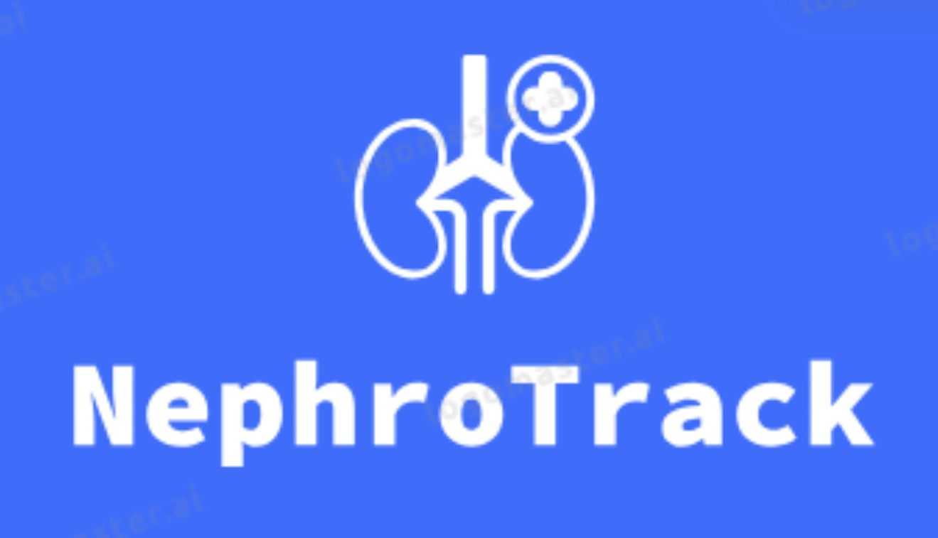

Design Approach & User Experience
We approached the design phase with a user-friendly mindset, prioritising clarity and simplicity for both clinicians and patients.
Created multiple logo concepts and explored colour palettes inspired by NHS branding (blue tones, soft neutrals).
Designed a UI that supports quick interaction, clean navigation, and is optimised for both mobile and tablet use.
Included concept mock-ups of key app screens (e.g., input screen, results summary, CKD stage display).
Ensured the layout followed accessibility standards, such as high contrast, large tap zones, and clean typography.
Chose icons and visuals to clearly indicate functions without overwhelming the user.

Slide 7
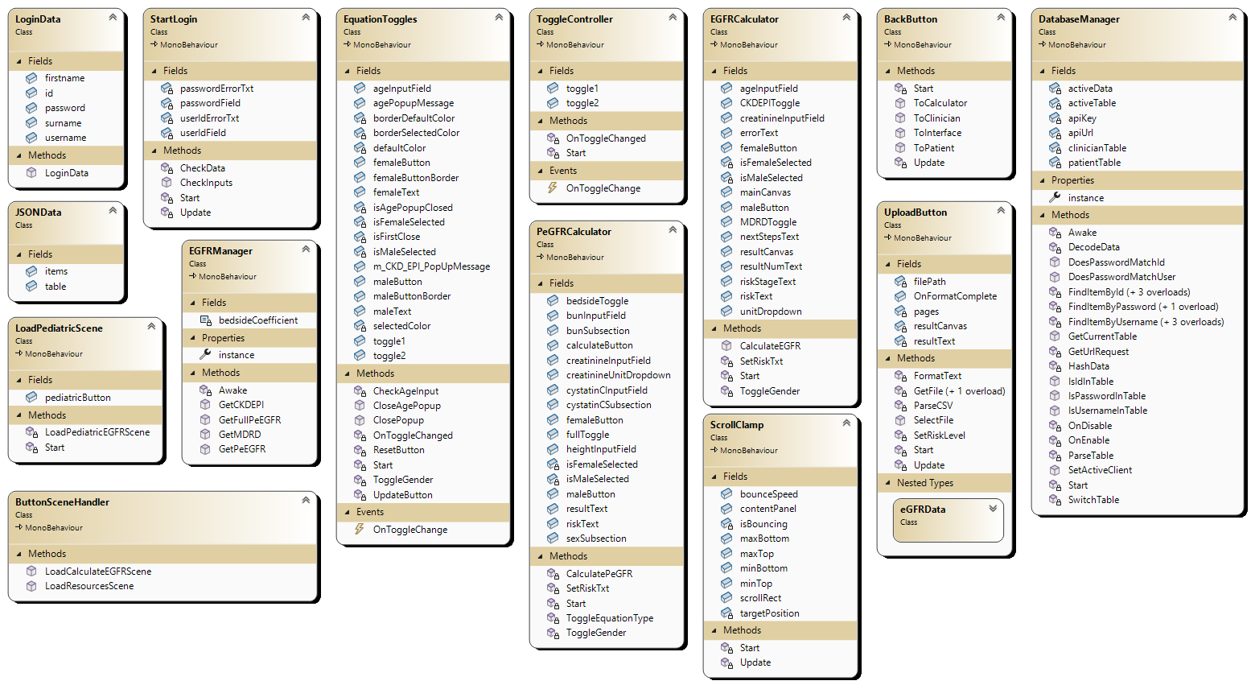
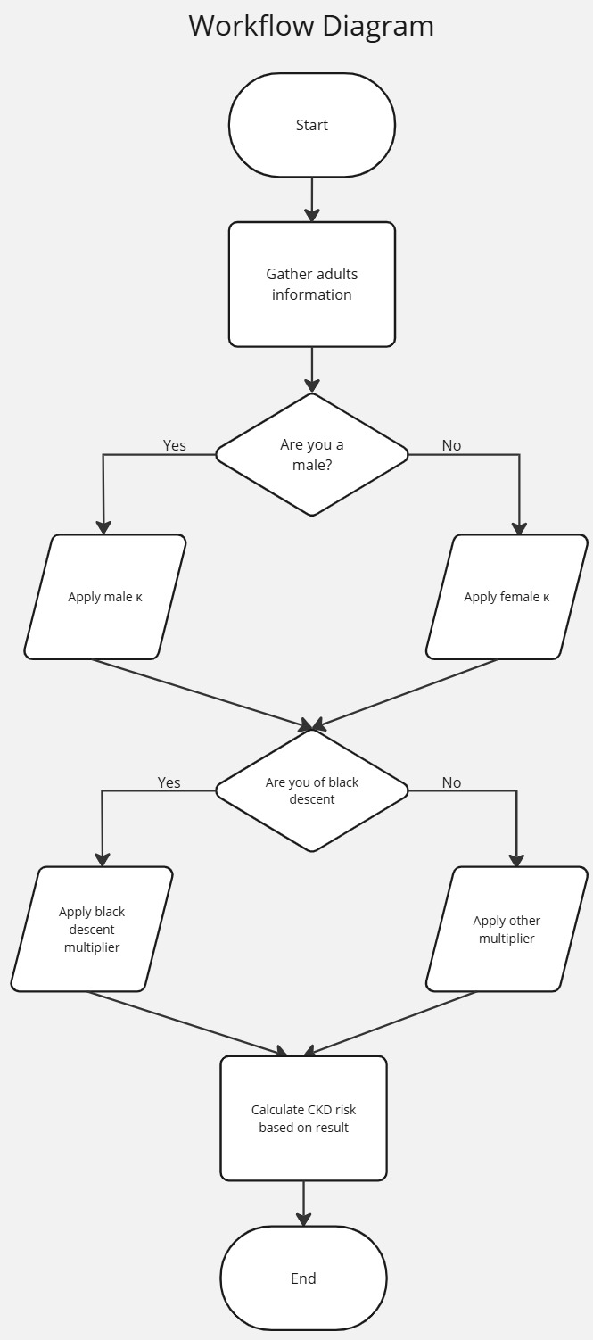
System Architecture & Platform Overview
The system is designed with a modular architecture, ensuring clean separation of logic and easy scalability.
Built with a mobile-first focus, ensuring accessibility across Android smartphones and tablets.
Divides users into clinicians and patients, each with distinct input flows and permissions.
Patient data is processed locally for single-use calculations, ensuring data privacy when login is not required.
Clinicians have access to batch upload features using CSV files for faster processing of patient lists.
No long-term data storage is used unless a patient logs in- aligning with the NHS preference for minimal data retention.
Currently using MDRD (without ethnicity) following national guidance to remove race-based variables. CKD-EPI and paediatric models are either implemented or under review for future expansion.
The exact CKD-EPI equation we are using is the 2021 Creatinine-Cystatin C equation.

Slide 8
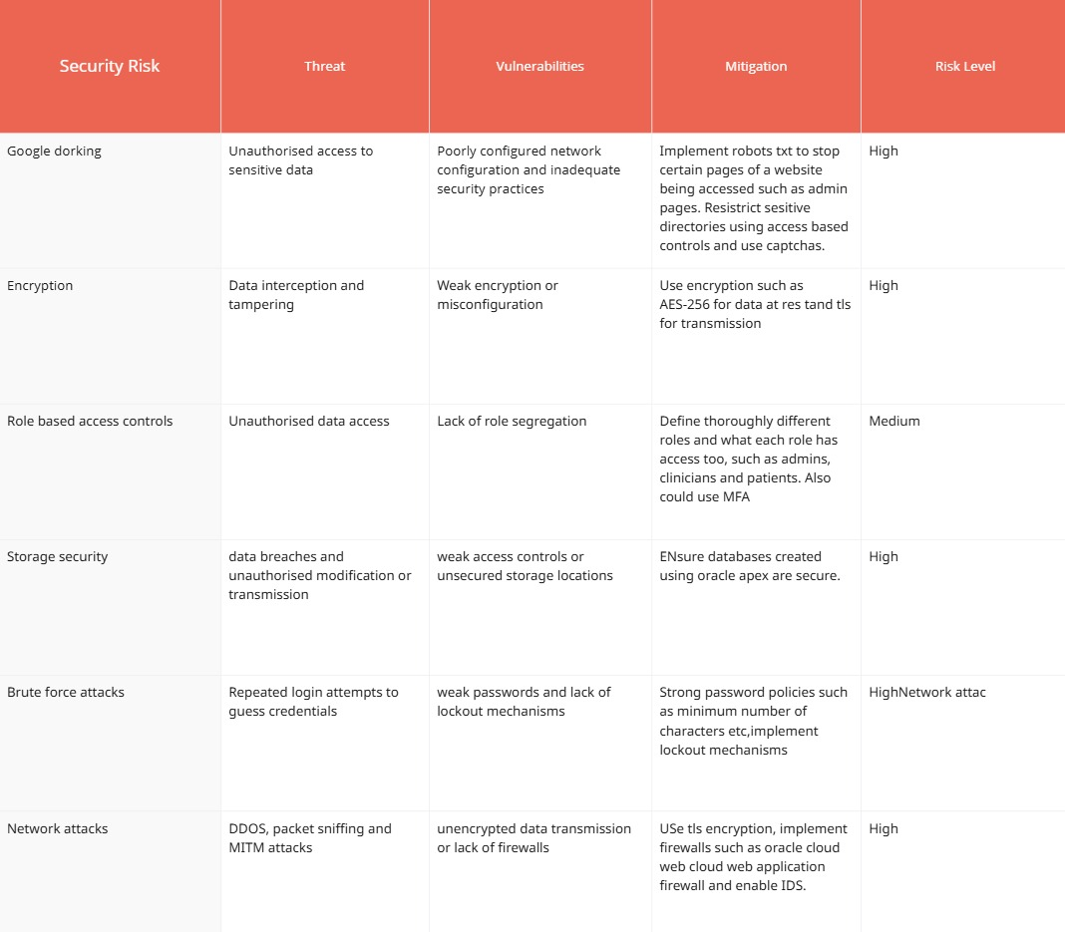
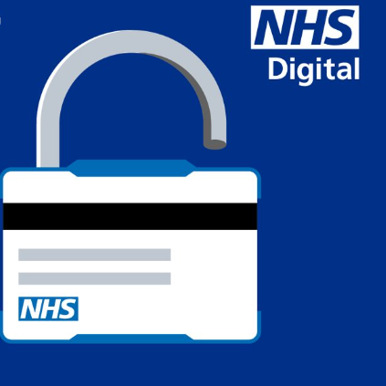
Security & Data Protection
The system was designed with a security-first mindset, in line with NHS and UK GDPR data protection principles.
No user data is stored unless explicitly required (e.g., login-enabled features for patients).
All single-use calculations are processed locally on-device, reducing external exposure of sensitive health data.
Batch uploads in CSV format are handled in-memory and are not saved after processing.
The app implements role-based access control, ensuring patients and clinicians see only relevant information.
Code was refactored to prevent the exposure of patient data outside of securely scoped, privately accessible functions that directly interact with the database.
When network communication is implemented, all data transmission will be secured following the HTTPS protocols.
Encryption and hashing for user credentials has been implemented, with future improvements in the next iteration stage.

Slide 9
Iterative Development Process
Our development followed an iterative approach, divided into two main sprints.
Each sprint was planned using task cards derived from user stories.
Iteration 1 focused on building calculators, login, and CSV batch upload functionality.
Iteration 2 introduced role-specific access, security upgrades, and report creation.
Regular testing and feedback sessions helped to refine usability and resolve bugs early in development.
Feature/Task | Sprint 1 (Iteration 1) | Sprint 2 (Iteration 2)
eGFR Calculator (Core) | DRD (adult), CKD-EPI, Paediatric | Refined logic + CKD stage display
User Flows | Patient & clinician input paths | Input validation + error handling
UI Design | Initial UI layout (mock-up screens) | Visual enhancements, accessibility adjustments
Authentication & Roles | Login system created | Role-based access, planned lockout logic
Batch Upload (Clinicians) | CSV upload support | UI improvements + validation
Security Measures | Local-only processing, no storage | Refactor scope, encryption + hashing (planned)
Feedback Testing | Informal feedback | Usability testing + refinement

Slide 10
Testing Strategy & Key Results
We developed a comprehensive test plan to validate app functionality, security, and usability.
Tests included:
Unit testing of the MDRD calculation logic
UI testing to ensure clarity and accessibility on various screen sizes
Security checks to prevent data leakage and validate role-based access
CSV input validation to handle incorrect or missing data in clinician uploads.
Based on feedback, we:
Improved error messages and added input validation for patient details
Adjusted layouts for better performance on android mobile devices
Key outcomes:
MDRD equation returned accurate CKD stage classification in 100% of test cases
Role separation (patient vs clinician) worked as expected
All critical paths passed functional tests successfully

Slide 11
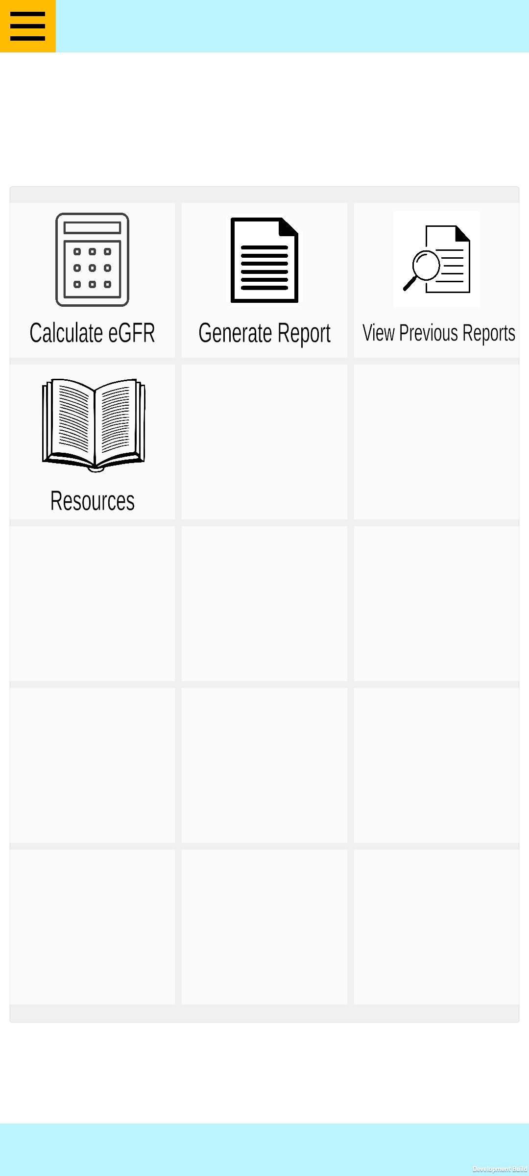
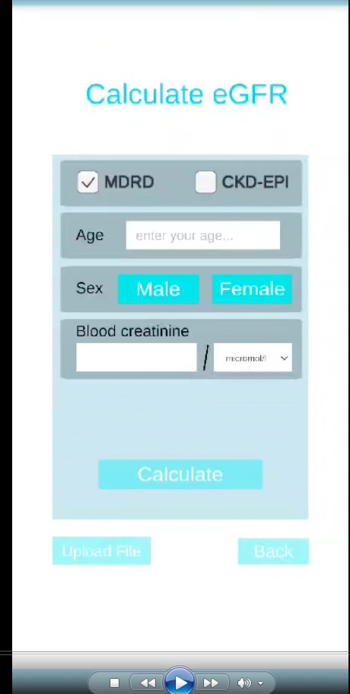
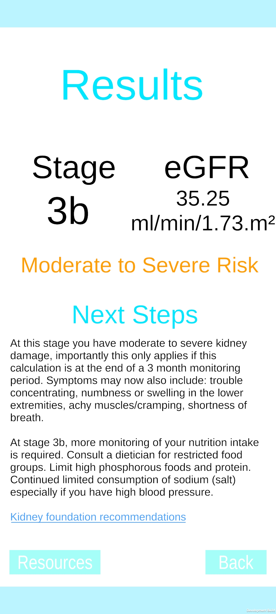
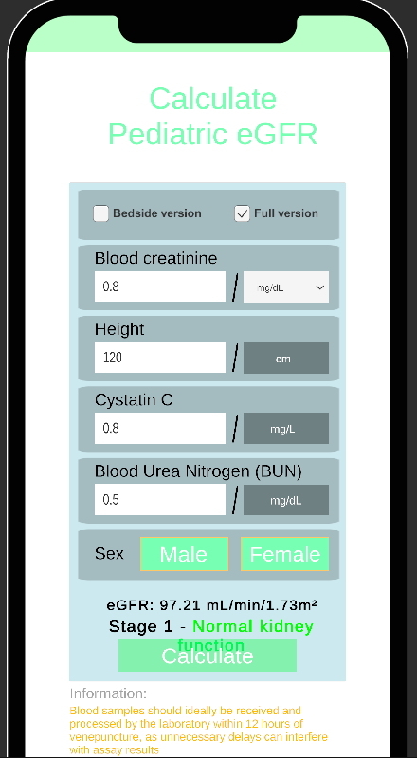
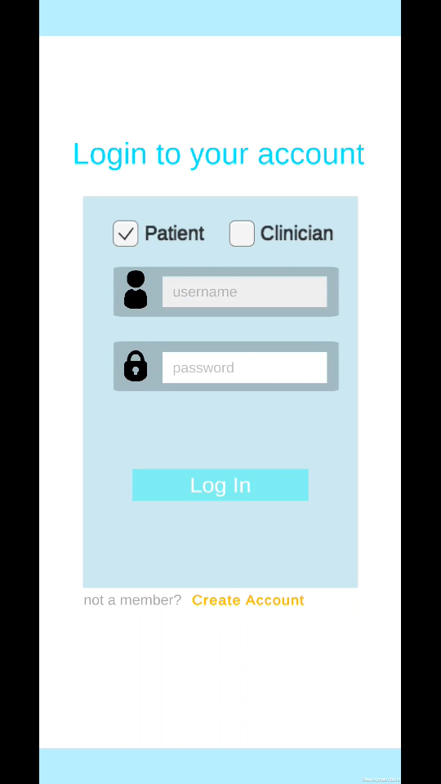
NephroTrack Prototype Demonstration
Our Prototype includes multiple working versions of NephroTrack, tailored to different user types.
The demo includes:
Standard User View – for adult patients using the MDRD equation.
Clinician View – includes advanced input, batch upload (CSV), and patient ID entry.
Features shown:
Inputting patient data (Creatinine, Age, Gender, Ethnicity)
Calculated eGFR result and CKD stage identification
Display of actionable advice based on stage (clinician vs patient views)
Clinician batch upload feature.

Slide 12
Planned Improvements & Future Development
Add secure patient login functionality with optional data history tracking.
Implement real-time cloud syncing for clinicians to view updates across devices.
Introduce dark mode and advanced accessibility options (e.g., text resizing, audio output).
Expand language support and easy read format for patient accessibility.
Consider integrating with NHS systems/APIs for faster data lookup and automated records.
Clinician
Explore AI-powered predictions or alerts for high-risk patients (stretch goal).
Clinician interface will have an option to see any patient record within the database their personal database, which is a feature the “expert patients” will not have.
Will have a memory feature to store and create an average of patient kidney levels over the last 3 months.

Slide 13
Questions & Discussions
Thank you for your time.
We’d love to hear your thoughts and answer any questions.

